Slide 1
Focus
Gaming Platform
Team 6
Carlos Vasquez, Chiayi(Millie) Tsai, Kartiki Saraf, Rozz Garrido, Miles Beler
Presentation date: 09.22.2021

Slide 2
Overview
Focus is a gaming platform to fulfill all your desire!
Play and explore over 365+ games here.
Easily find the game through our filter feature.
Add your favorite games to My Favorite pocket and play them whenever you want.
Elevator Pitch
Concept
Why, Who & What
Design Process
How, Challenges, & Improvements
Meet Focus

Slide 3
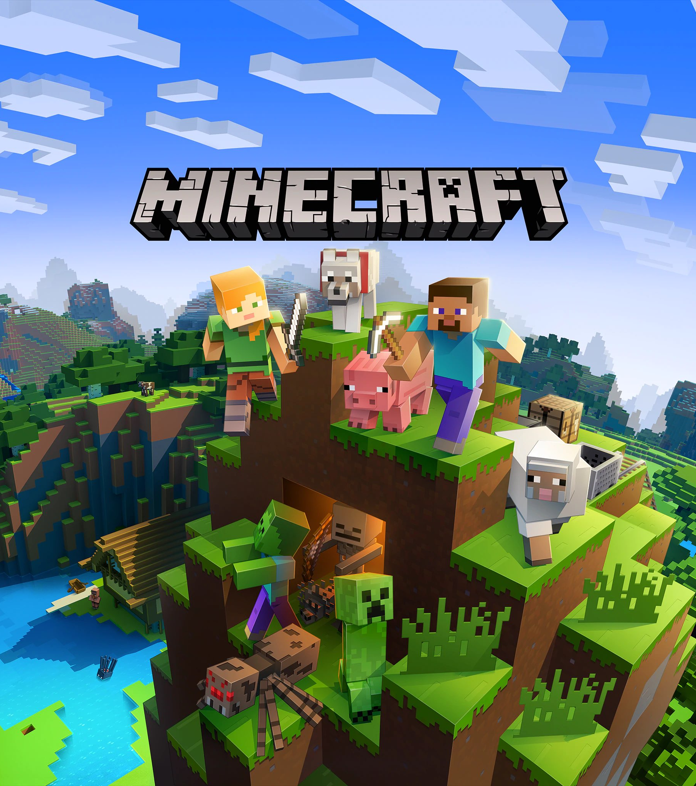
Why Focus?
Can’t find the game you want ?
Would like to try different games in a place?
Want to save the favorite games?
Then Try Focus!

Slide 4
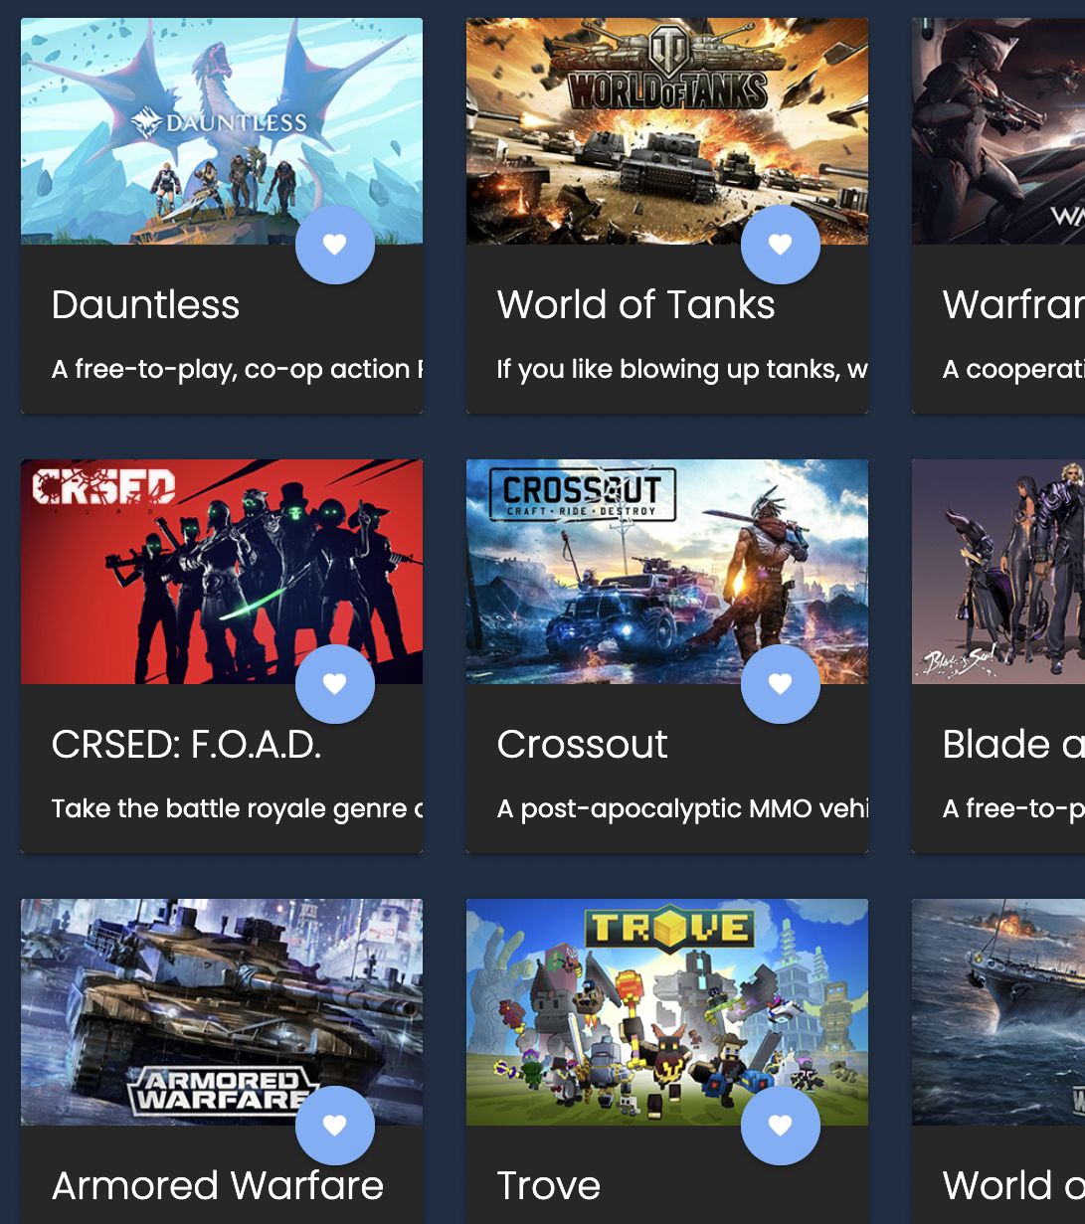
Play & Explore
We are offering over 1000+ games for different platforms.
Play and explore more games!

Slide 5
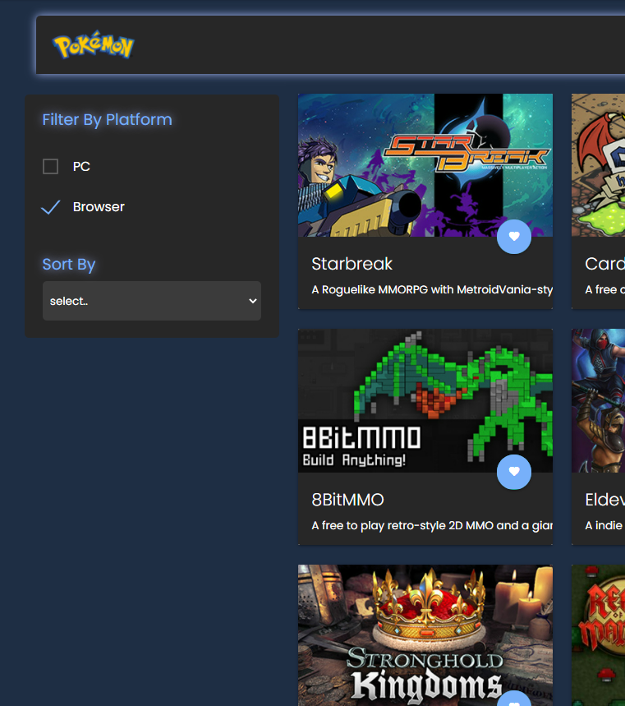
Filter and Sort Games
You can easily filter & sort them to find the one!

Slide 6
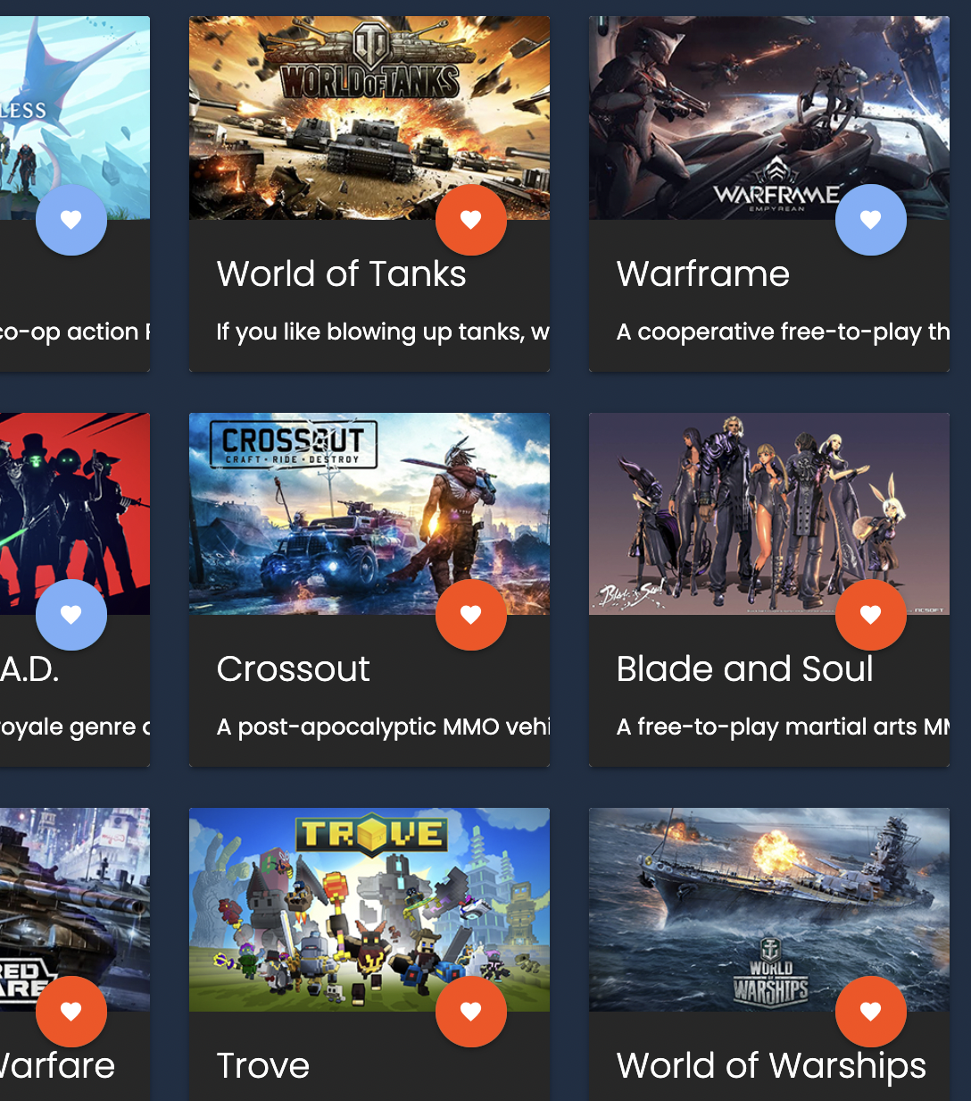
My Favorite
Add any games to My Favorite with a simple click!
Play them whenever you want

Slide 7

Pokémon
Good News!
Pokémon is in Focus and Free!

Slide 8
Design Process

Slide 9
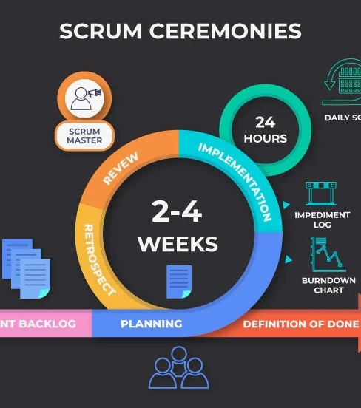
Agile Development
Brainstorming
User Stories
Wireframe
Sourcing API & CSS framework
Daily Standup
Sprint Review

Slide 10
Brainstorming
Recipe lookup
Interactive Recipe Book
Gaming site
To-Do list
Daily Planner
Artist Portfolio
Calculator

Slide 11
User Story
As a user, I want to see tiles of games so that I can choose what I want to play.
As a user, I want to filter games’ tiles by its platform so that I can find my specific game.
As a user, I want to select a game to play so that I can know if I like it or not.
As a user, I want to select a Pokémon game tile so that I can play the game.
As a user, I want to play the Pokémon game on the site so that I can have fun.
As a user, I want to add my favorite game to the game collector box so that I can check them quickly.
Link

Slide 12
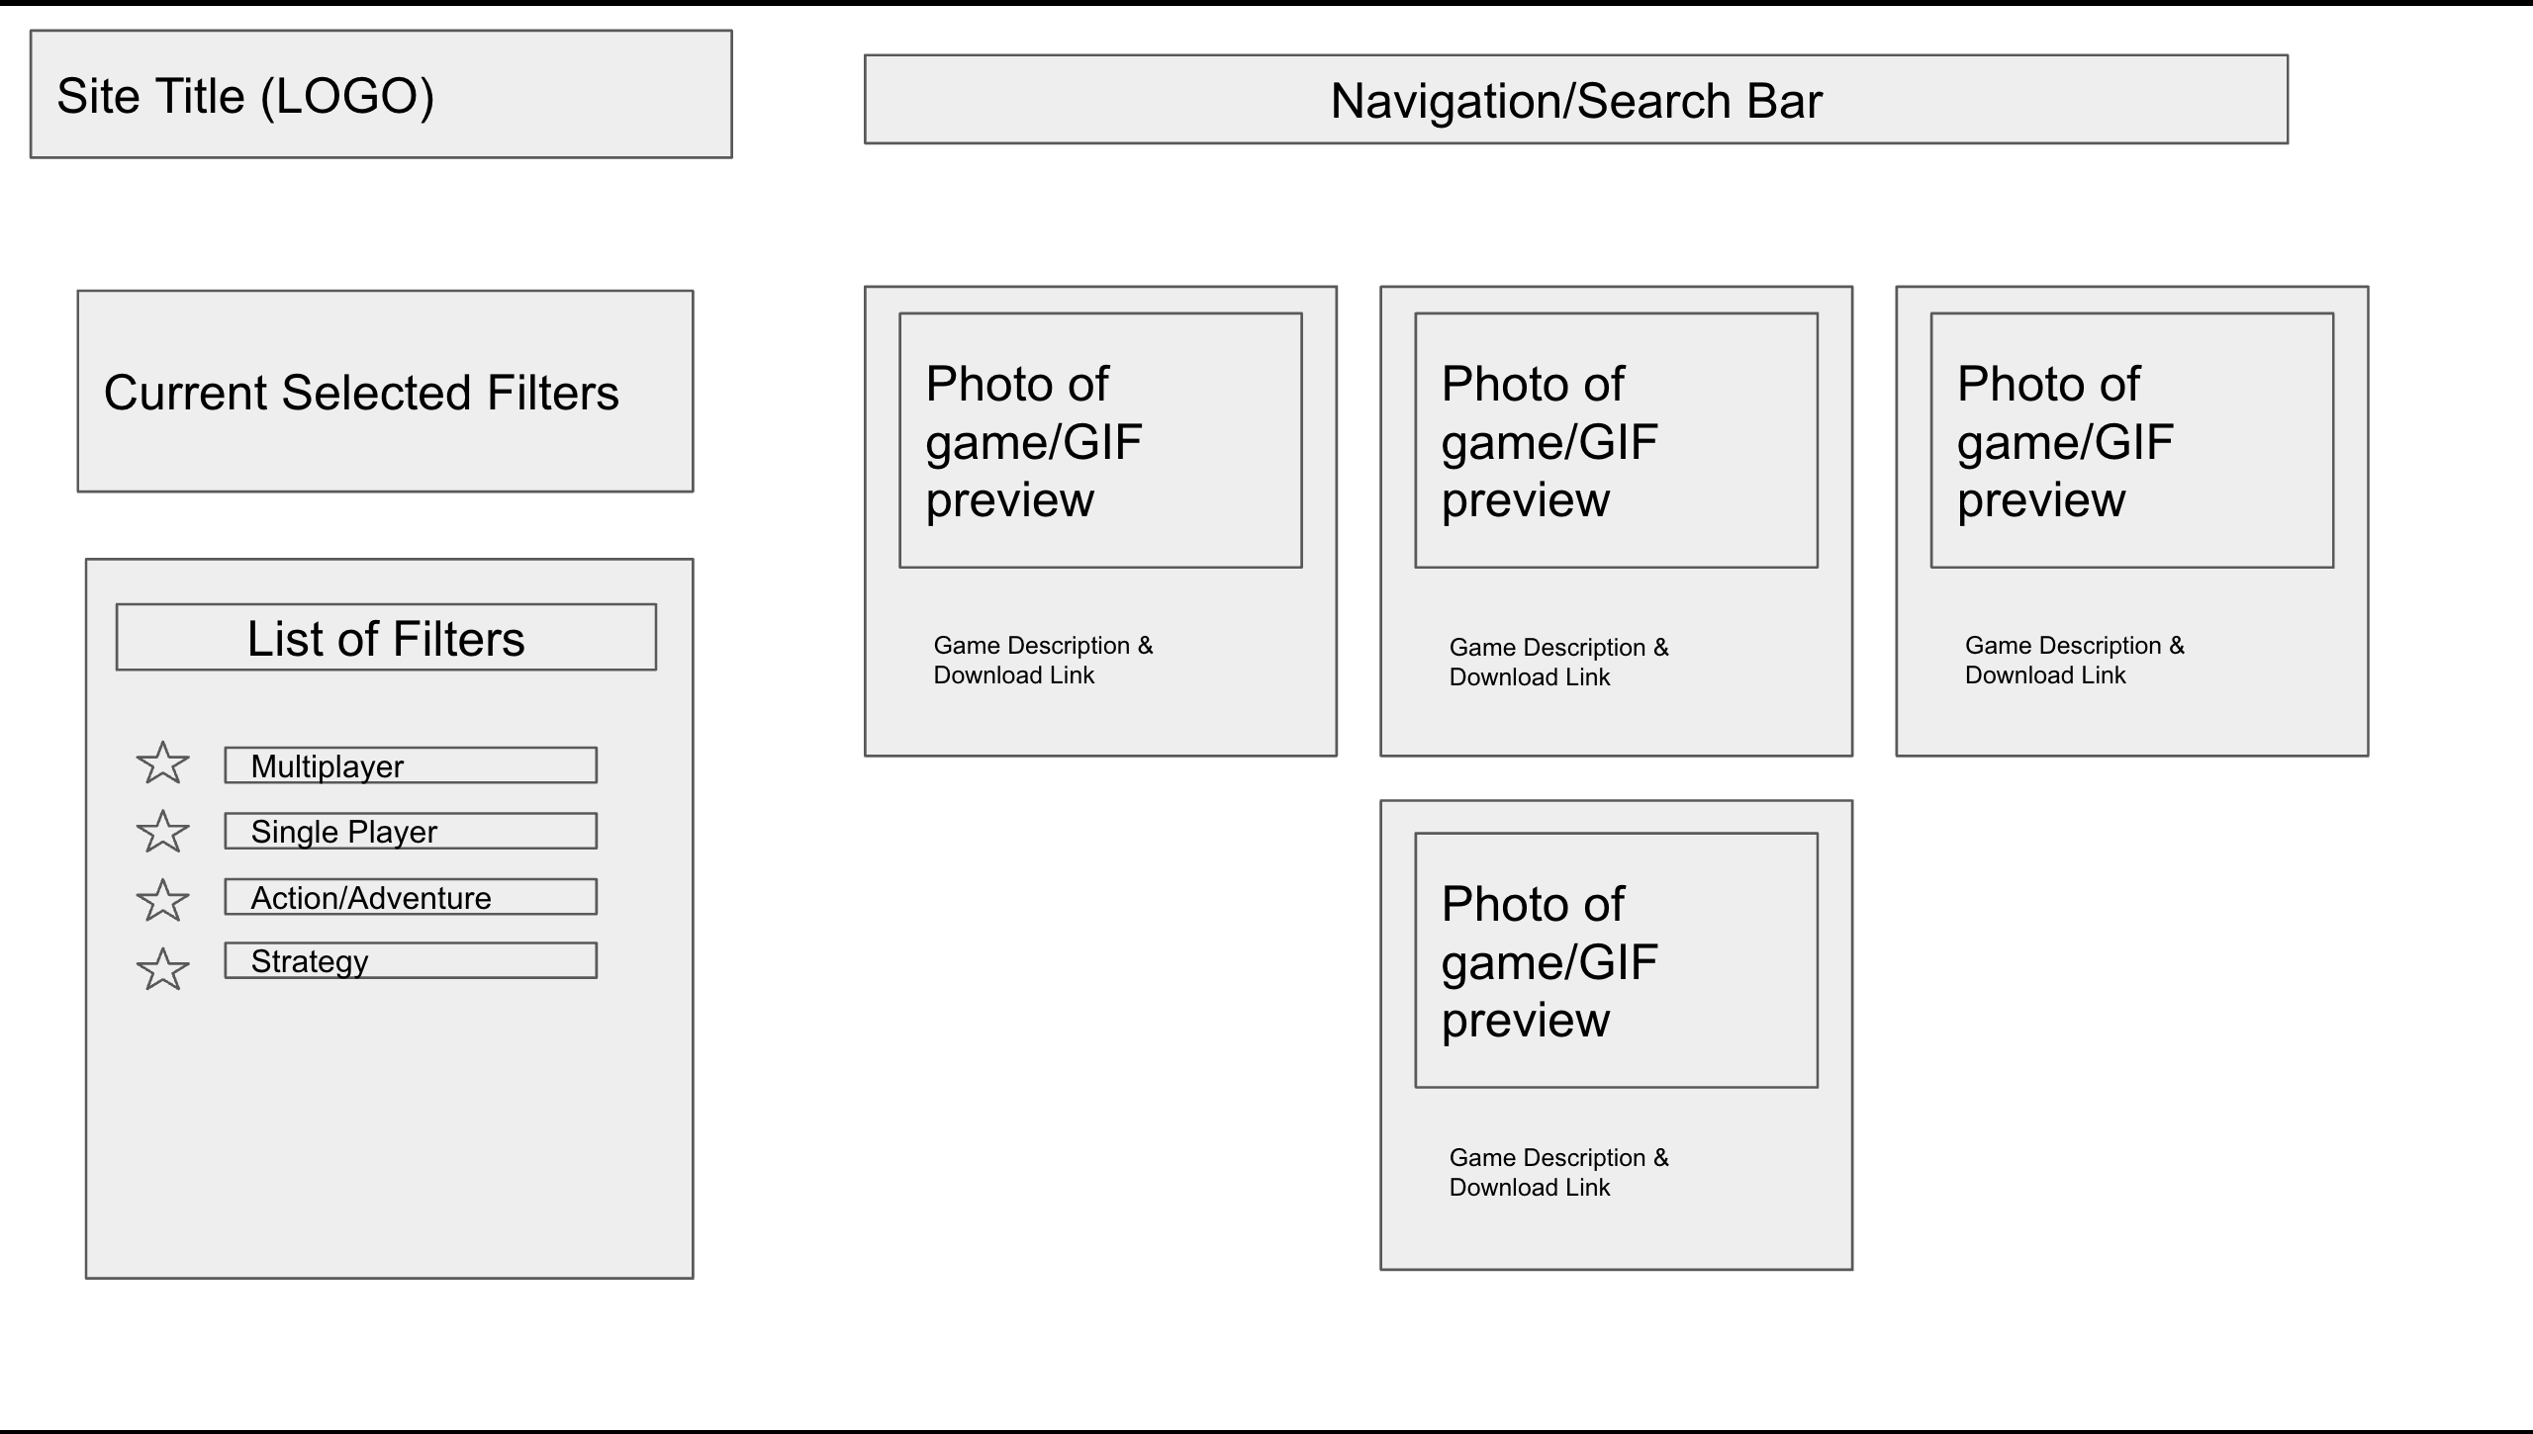
Wireframes

Slide 13
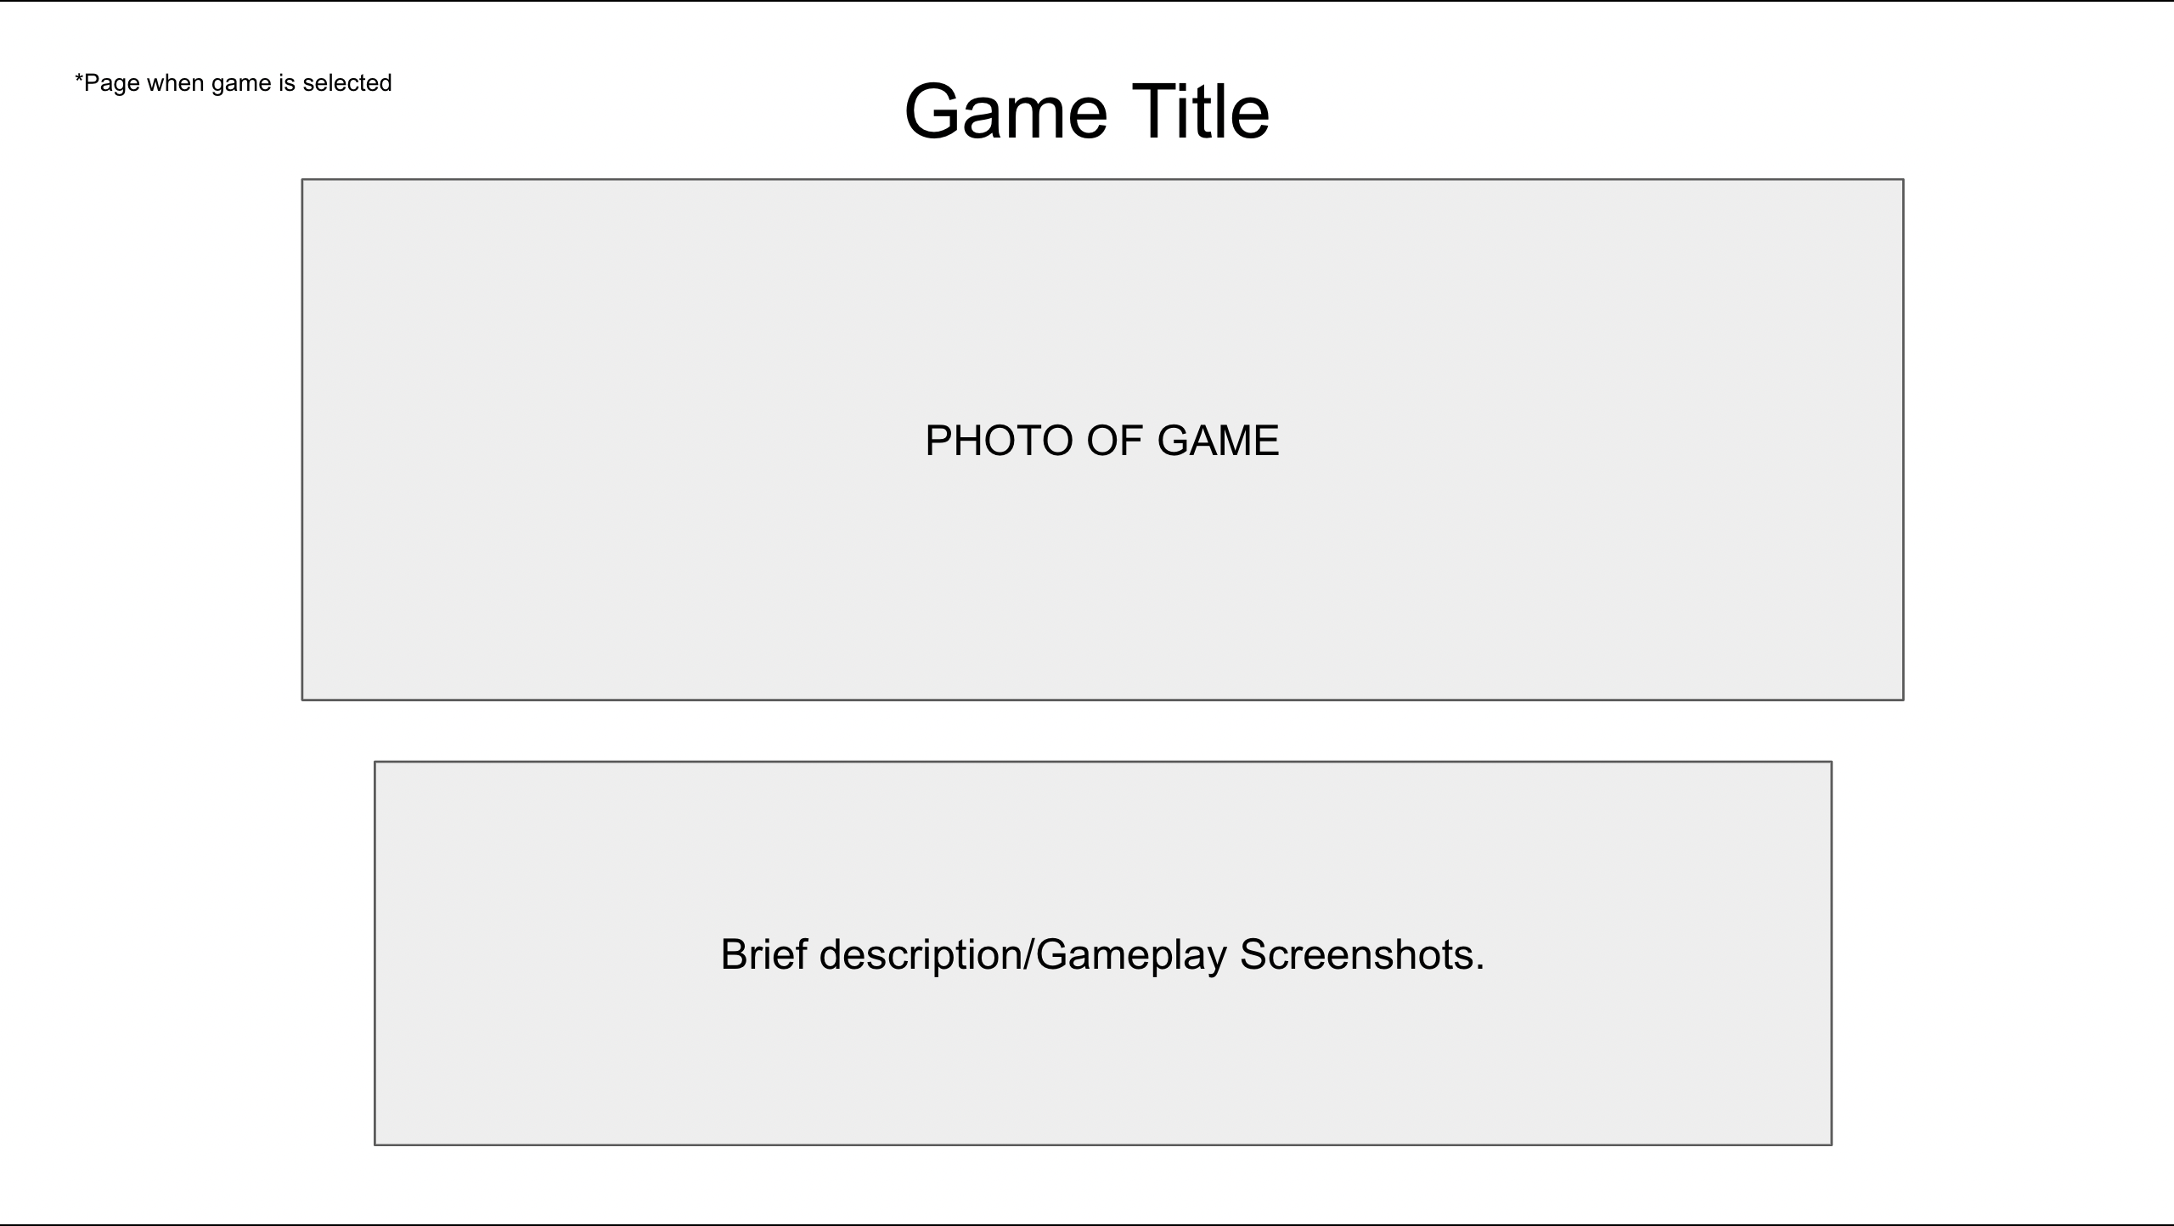
Wireframes

Slide 14
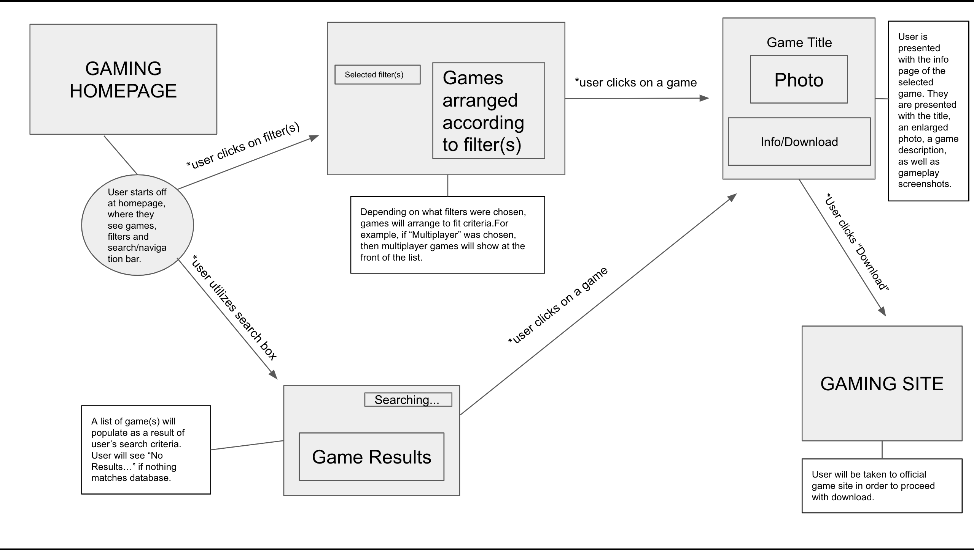
Wireframes

Slide 15
Task Breakdown & Roles
Carlos Vasquez:
Pagination, footer, Pokémon API, merge branches
Kartiki Saraf:
Sourcing API, Free-To-Play Games API, Pokémon API, GitHub setup, JavaScript, my favorite list, merge branches, nav bar & pagination (responsive), sorting, and filter
Rozz Garrido:
Wireframe, filter functionality
Chiayi (Millie) Tsai:
User stories, acceptance criteria, game cards, favorite button, google font, css framework, nav bar, merge branches, Pokémon page, ppt
Miles Beler:
Header

Slide 16
Technologies
HTML
CSS
JavaScript
jQuery
Materialize CSS framework
APIs:
Free-To-Play Games API
Pokémon API

Slide 17

Tools
VS Code
Git Bash
GitHub
GIT
Jira
Google Doc
Zoom
Slack

Slide 18
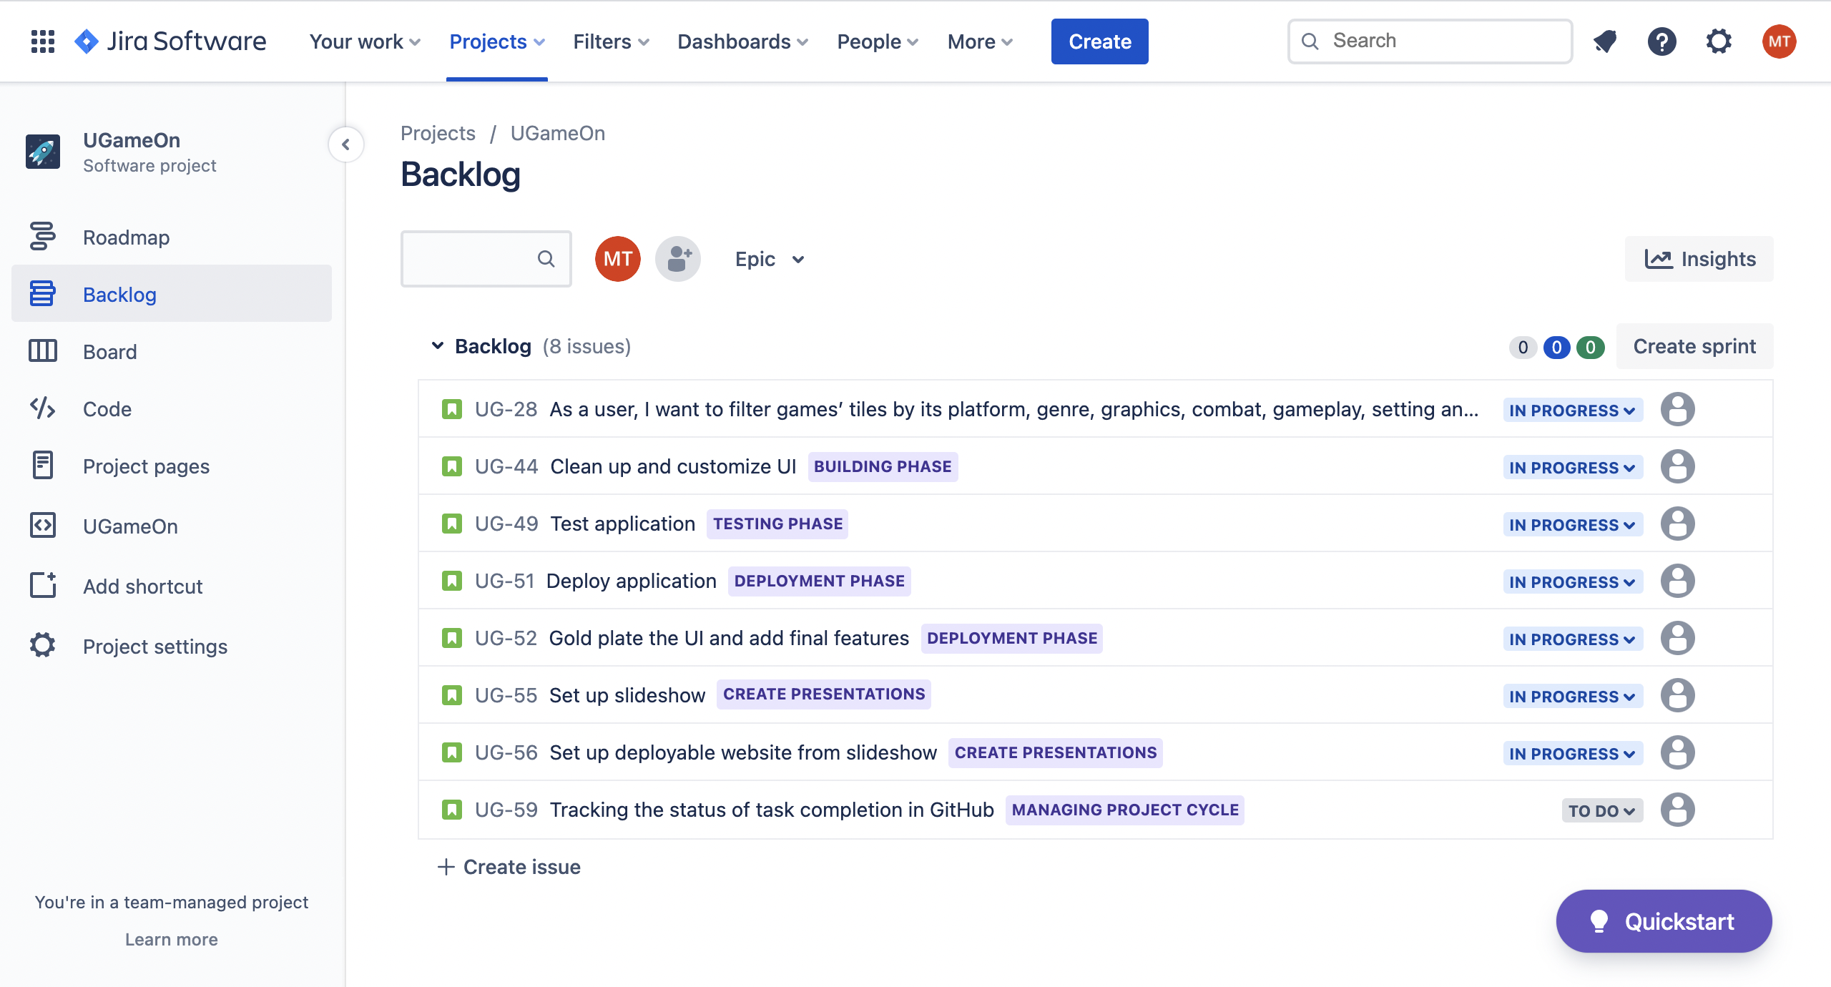

Slide 19
Challenges
GitHub crashed
Merge different branches
Repeated naming ID or Class
Unknown issues

Slide 20
Future Improvement
Enhance My favorite, like add a delete icon
Improve responsive layout
Add About
Add facebook Login
Add sorting function, like relevance, popularity
Add a search function to find the game by its name

Slide 21

Success is Here
Let’s meet Focus!
Focus website: https://ks1.github.io/UGameOn/
GitHub repo: https://github.com/KS1/UGameOn

Slide 22
!!! Demo Time !!!
Console.log(“Focus on what you want and get it!”)

